Slide 1
Call - Subroutine

Slide 2
Subroutine
Program Test
call out_hello()
call out_hello()
End Program test
Subroutine out_hello()
print*,’hello’
End subroutine
To shorten the length of the main program and let your program looks more simple.

Slide 3
Subroutine
Subroutine and Main program are two independent processes. Independent variables and labels. It means you can repeat them in your main and sub program.
Subroutine can call subroutine!

Slide 4
Call by address/reference
Program test
integer I
real x
call tt(i,x)
print*,I,x
End program test
3 0.15
Subroutine tt(i,x)
integer :: i=3
real :: x=0.15
End subroutine tt

Slide 5
Call by address/value
Call by address (Fortran)
Variable changes in subroutine and also changes in the main program.
Call by value (C has this function)
Just pass the values, does not change value in the main program.

Slide 6
Pass array values-exercise
Real a(1000)
!– pass a real vlaue
Call test1(a(1))
!– pass a real array
Call test(a)
Subroutine test1(a)
real a
a=1*1.5
End subroutine test1
Subroutine test(a)
real a(1000)
do i=1,1000
a(i)=i*1.5
enddo
End subroutine test

Slide 7
陣列傳值需注意事項 To note about passing value of array
Must to map same size and position
A(100,100) ➔ A(10000) will not have a error, but array elements in different position

Slide 8
User defined Function 自訂函數
呼叫function前要宣告
Name of function must be declared. It is variable
Function執行後會傳回一個數值
End of function must return a value

Slide 9
Function 自訂函數-exercise
Main
Program main
real add
real a,b,c
c=add(a,b)
End program main
Function
Real function add(e,f)
real e,f
add=e+f
return
End function add

Slide 10
Common全域變數不用傳值 Common – global variable declare
Program test
integer a,b,c,d
common /tw/ a, b
common /us/ c, d
a=1
b=1
c=1
d=1
call tt()
End program test
Subroutine tt()
integer a,b,c,d
common /tw/ a, b
common /us/ c, d
print *,a+b+c+d
End subroutine tt
Run
4

Slide 11
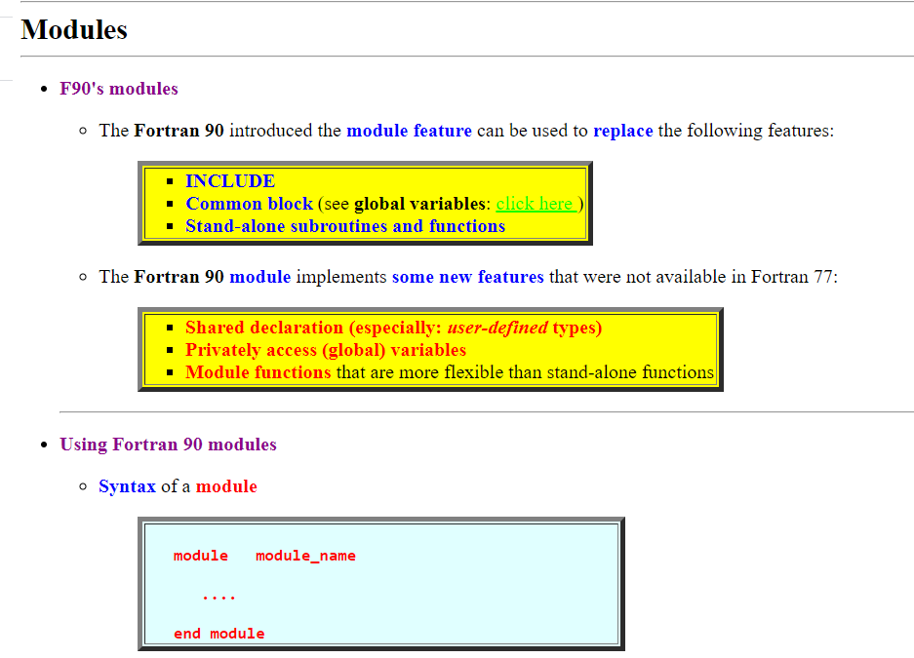

Slide 12
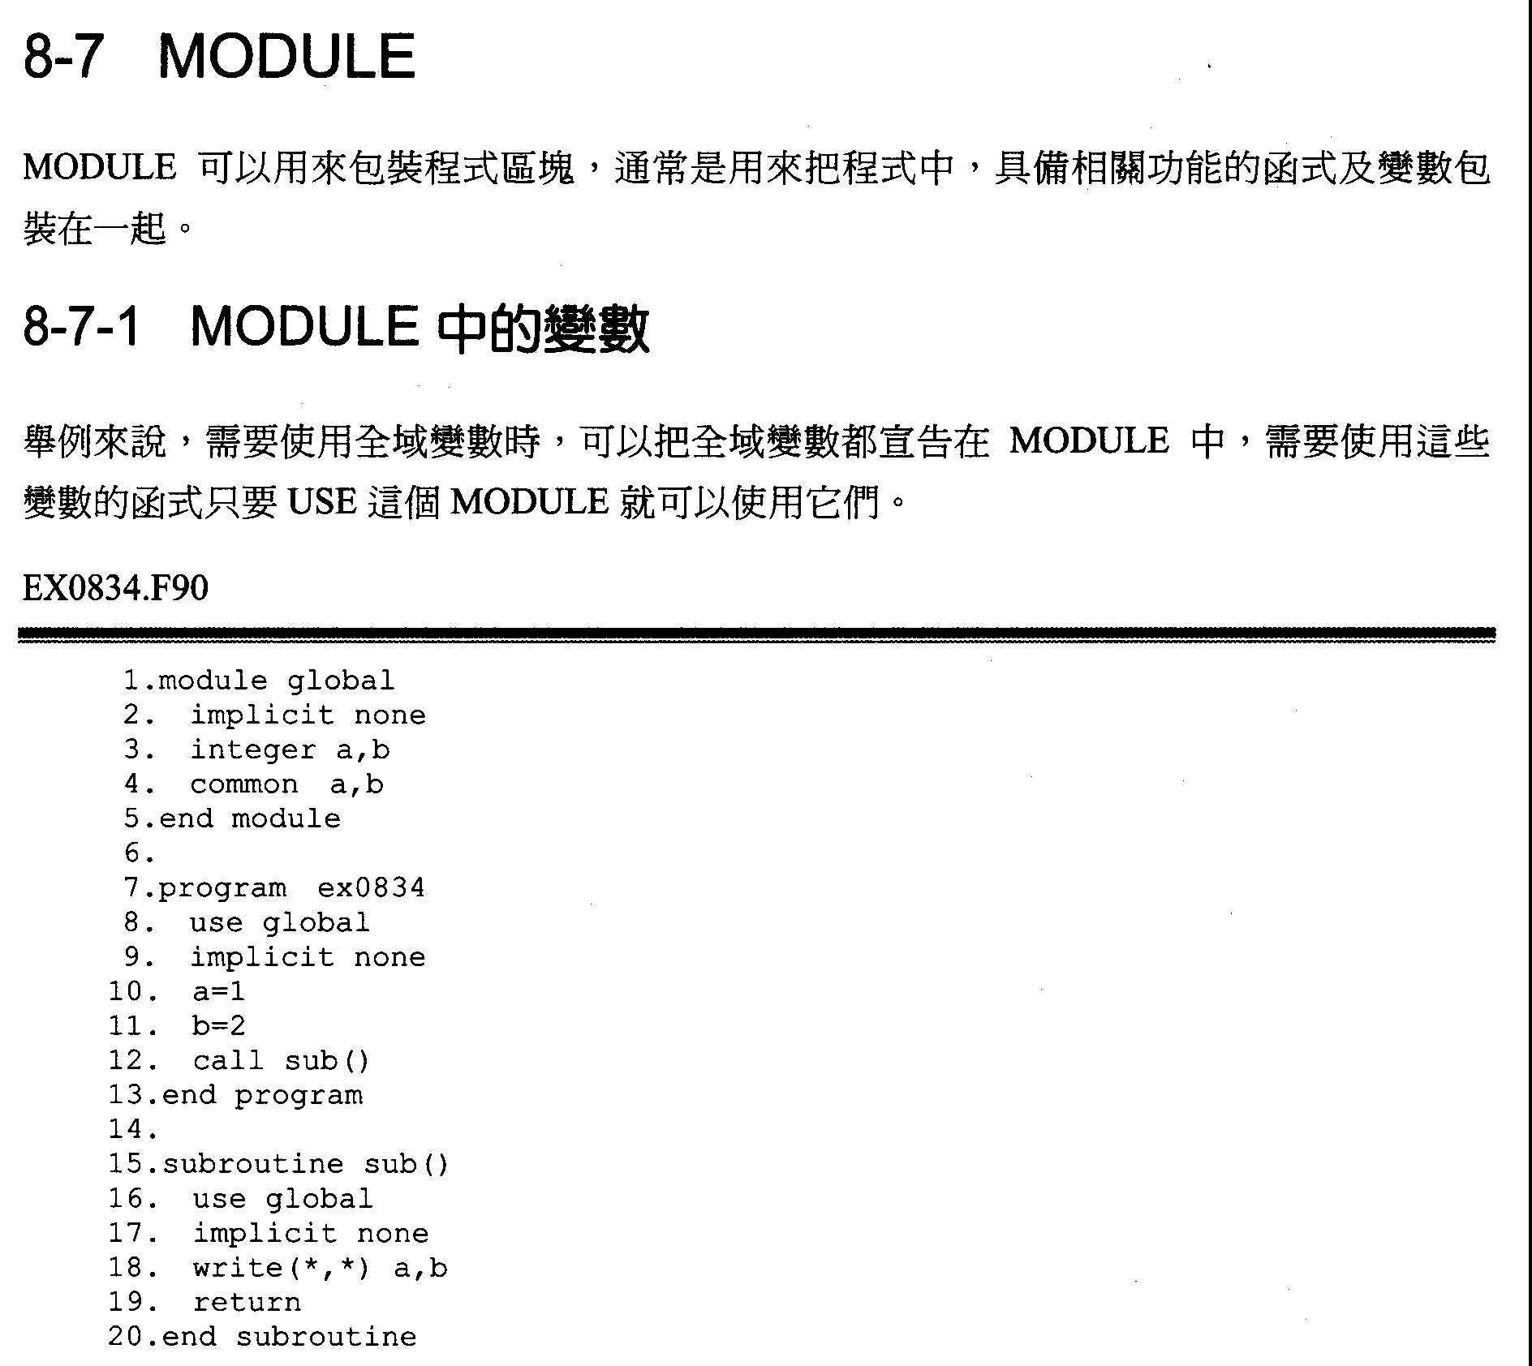
MODULE can be used to pakage a block of code. It’s often to used on packaging related function
and variables.
For instance, global variables can be declared in a MODULE, USE the MODULE when these
variables are needed.

Slide 14
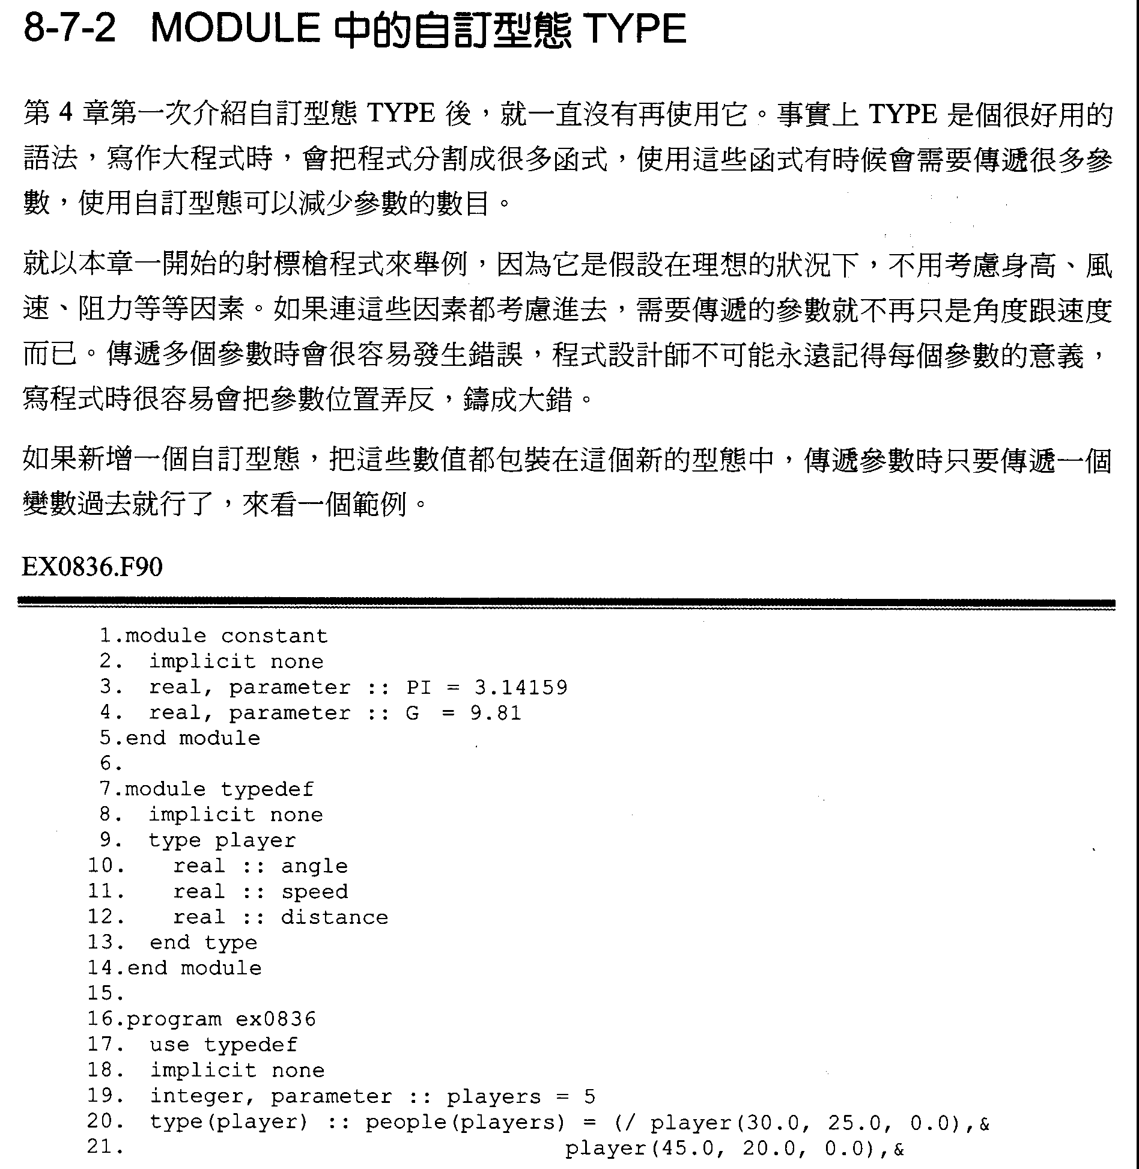
TYPE is a useful grammar. When writing a big program, the program is often to be separated to many functions, which require to transfer many arguments. Using TYPE can reduce the number of arguments.
Take Javelin Throw as an example. It is assumed in an ideal case that height, wind speed, and resistant force are not included. If these factors are included, more arguments need to be transfer instead of merely angle and velocity. When large amount of arguments need to be transferred, it’s easy to go wrong. It’s hard for programmers to remember the definition of each arguments. If locations of arguments are wrong, the program will go wrong.
If a new TYPE are defined and related arguments are included in it. Only one variable need to be transferred. Let’s see an example.

Slide 16
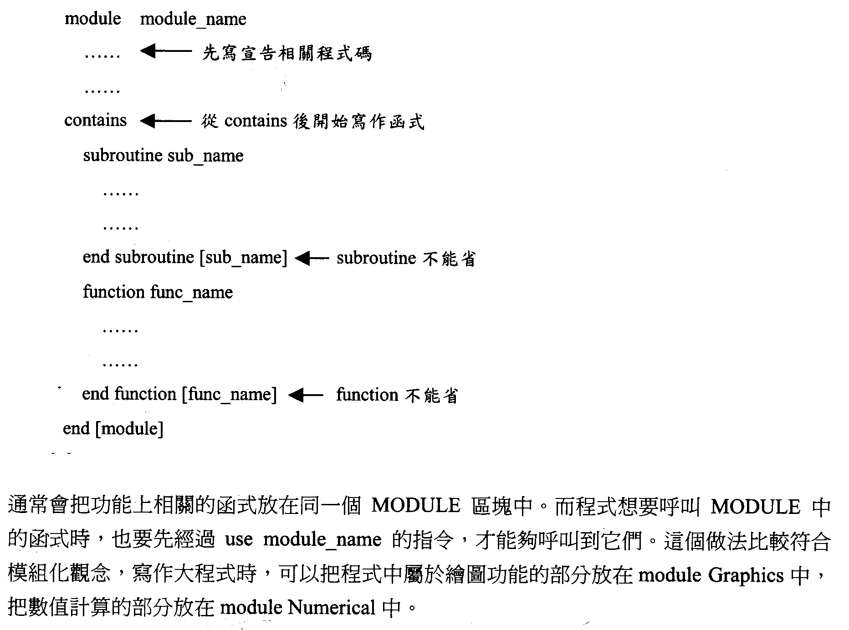
Declare related code
Write the function after contains
subroutine can’t be omitted
function can’t be omitted
Usually, related functions will be put in the same MODULE. When a program want to call a function in a MODULE, “use module_name” are required to used to call it. This way is fit with modular design. When writing a big program, graphing related functions can be put in “module Graphics”, numerical related functions can be put in “module Numerical”.

Slide 18
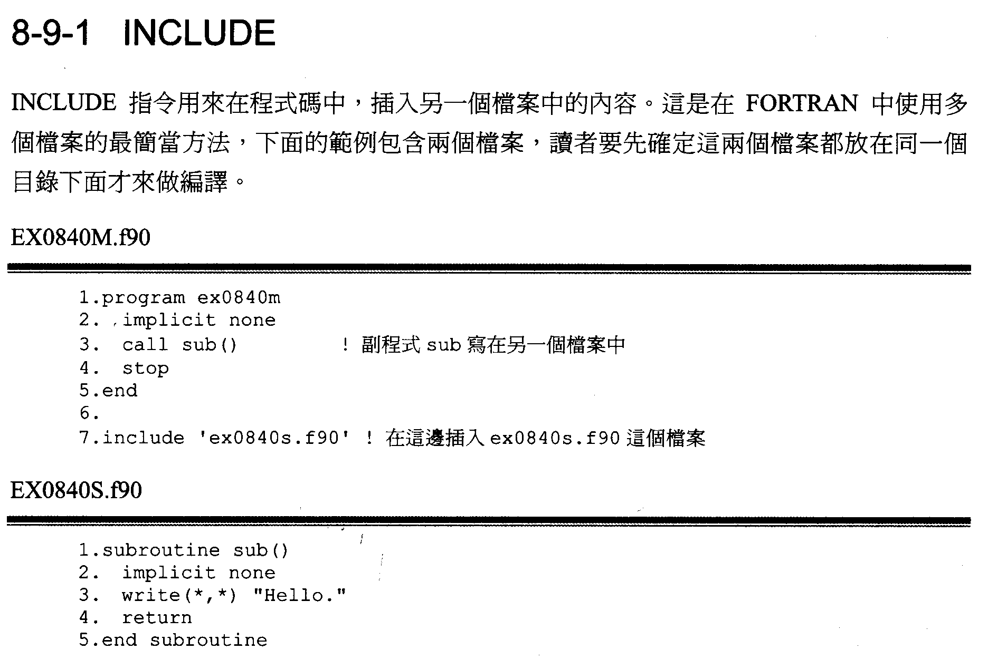
INCLUDE are used to include the content from another file. It’s the easiest way to use many files in the same time. The following example includes two files. The two files should be put in the same path for compile.
function sub is in another file
include ex0840s.f90

Slide 20
INCLUDE_FILES, a FORTRAN90 code which makes a copy of a FORTRAN file, in which INCLUDE statements are replaced by the corresponding include files.
The format for a FORTRAN include statement is either
include 'file.txt'
or
include "file.txt"
This program reads a file with such include statements, and replaces each such occurrence by the text of the corresponding file.

Slide 21
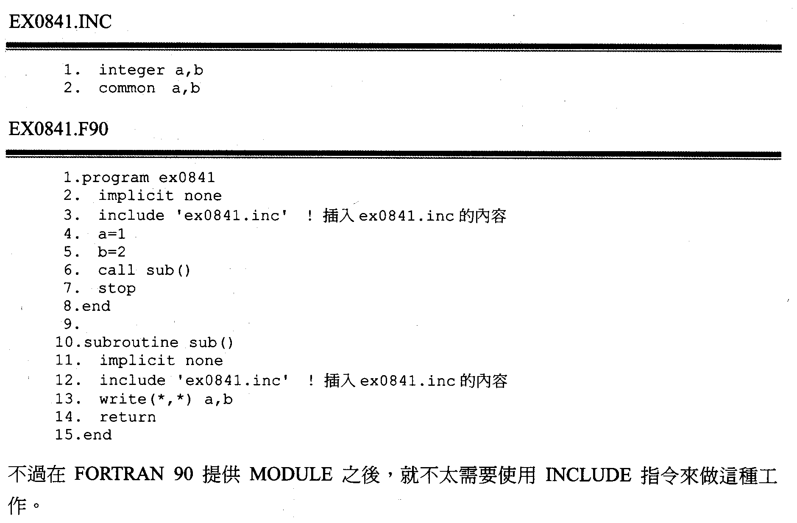
After FORTRAN 90 provide MODULE, INCLUDE are less to be used to do the job.

Slide 23
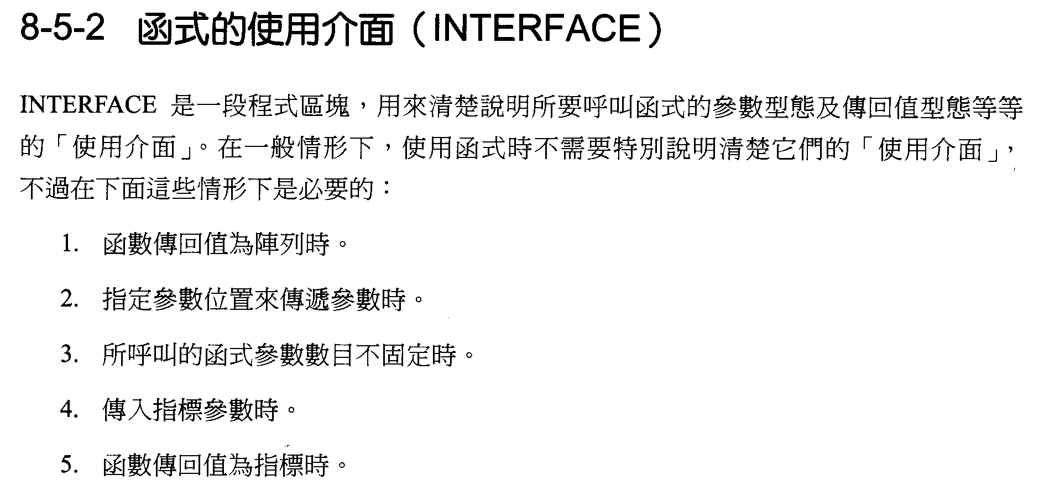
INTERFACE is a block of code. It’s an “interface” to illustrate type of arguments for calling a function and the type of return value. In most cases, it’s not necessary to illustrate their “interface” when calling a function. However, the following cases is requiring it:
Return value is an array.
Assign a location of a argument to send it.
The number of arguments with the calling function is not fixed.
Sending a POINTER.
Return value is a POINTER

Slide 25
Interface
Statement Purpose
The INTERFACE statement is the first statement in an interface block. The interface block is a powerful structure that was introduced in FORTRAN 90. When used, it gives a calling procedure the full knowledge of the types and characteristics of the dummy arguments that are used inside of the procedure that it references. This can be a very good thing as it provides a way to execute some safety checks when compiling the program. Because the main program knows what argument types should be sent to the referenced procedure, it can check to see whether or not this is the case. If not, the compiler will return an error message when you attempt to compile the program. Also with just a slight variation, it can then be used to create generic functions for use inside of a program unit.

Slide 26
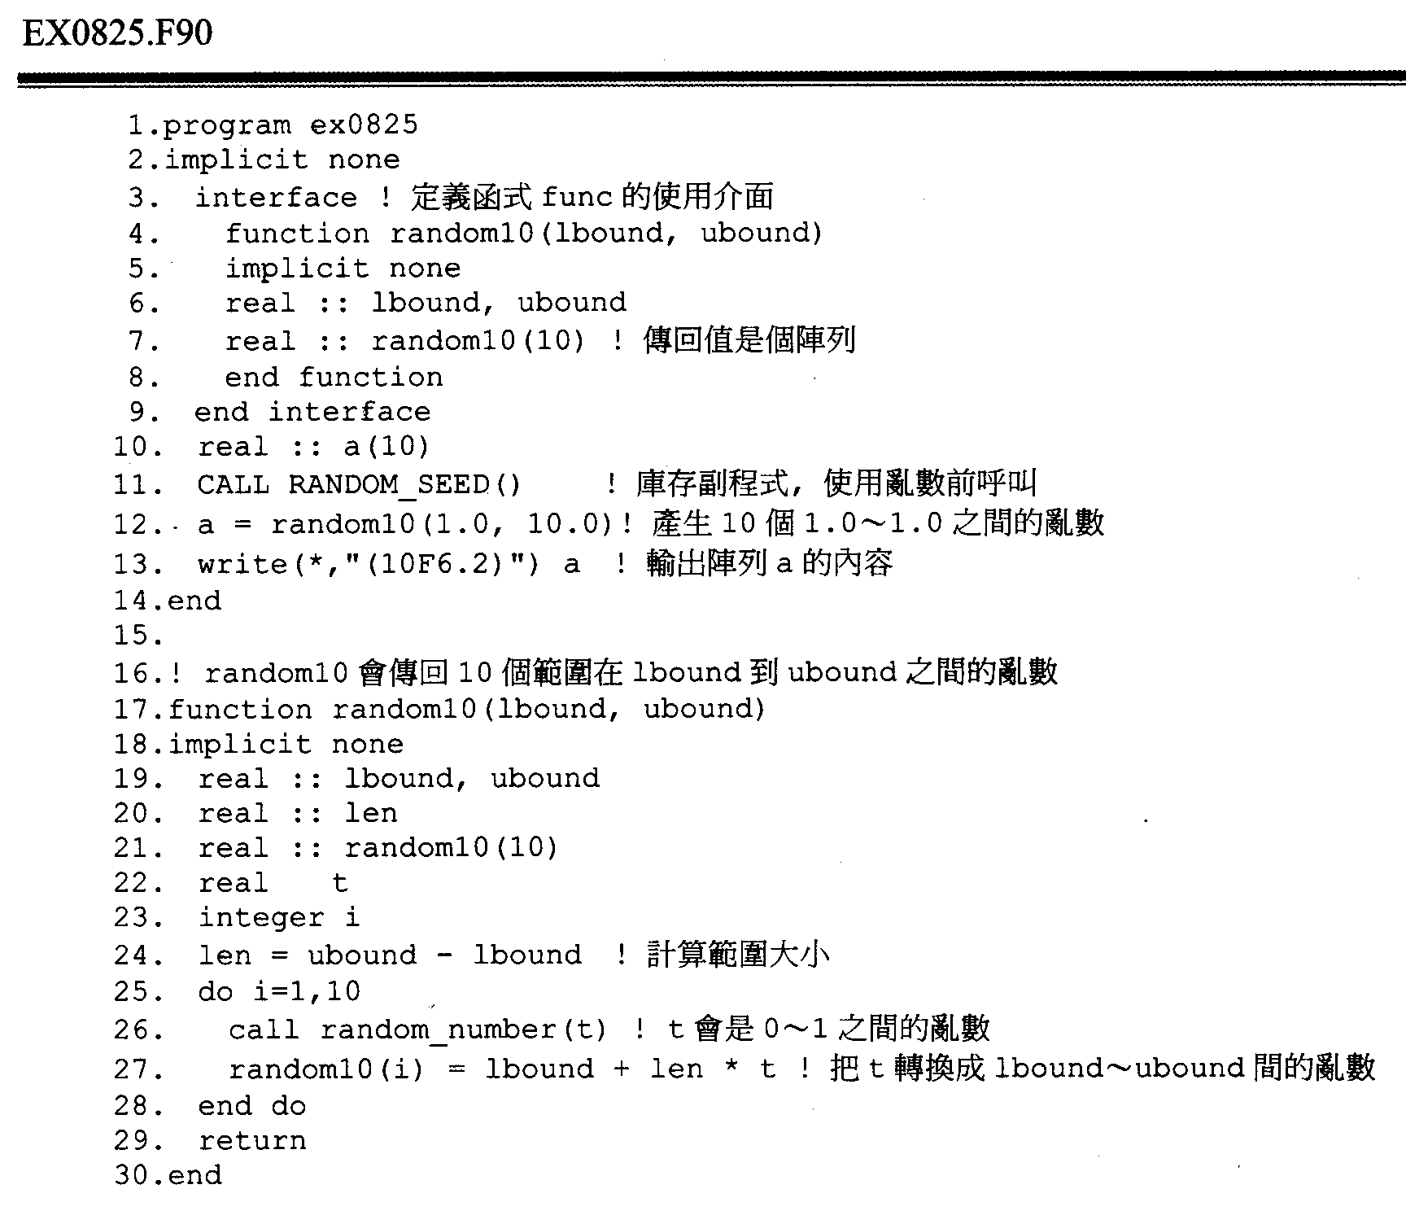

Slide 27
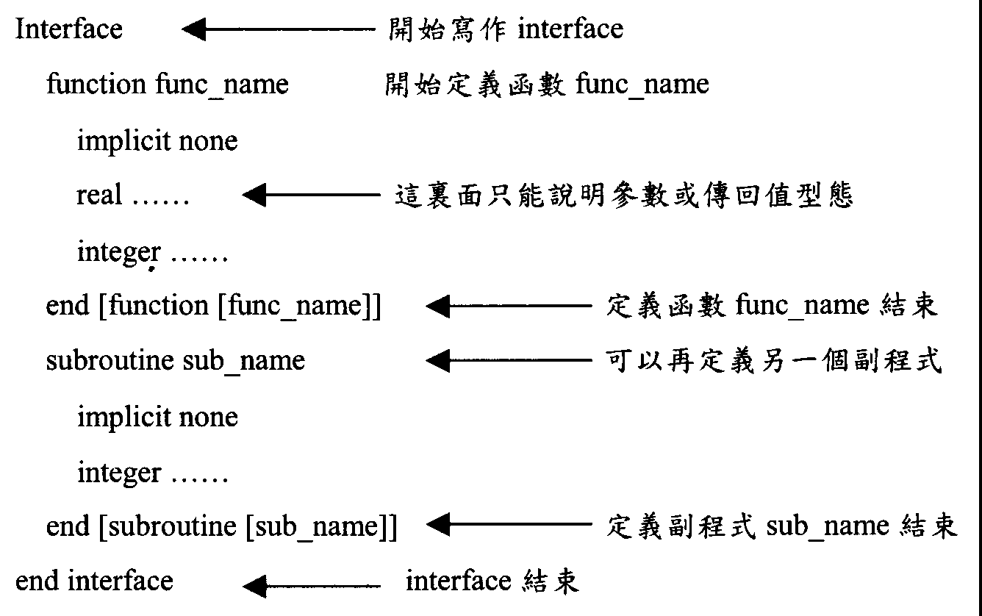
Start interface
Define function func_name
Only for illustrating the type of arguments or return values
End function func_name
Can define another subroutine
End subroutine sub_name
End interface

Slide 29
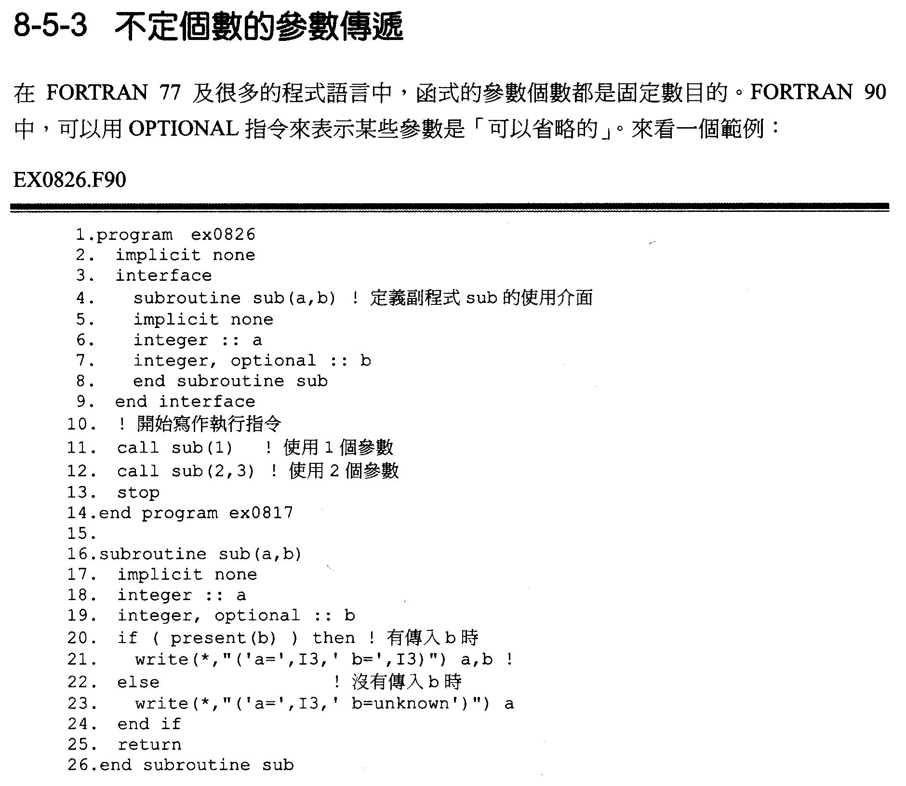
In FORTRAN 77 and some languages, the number of arguments with a function is fixed.
In FORTRAN 90, OPTIONAL can be used to indicate that some arguments can be omitted.

Slide 31
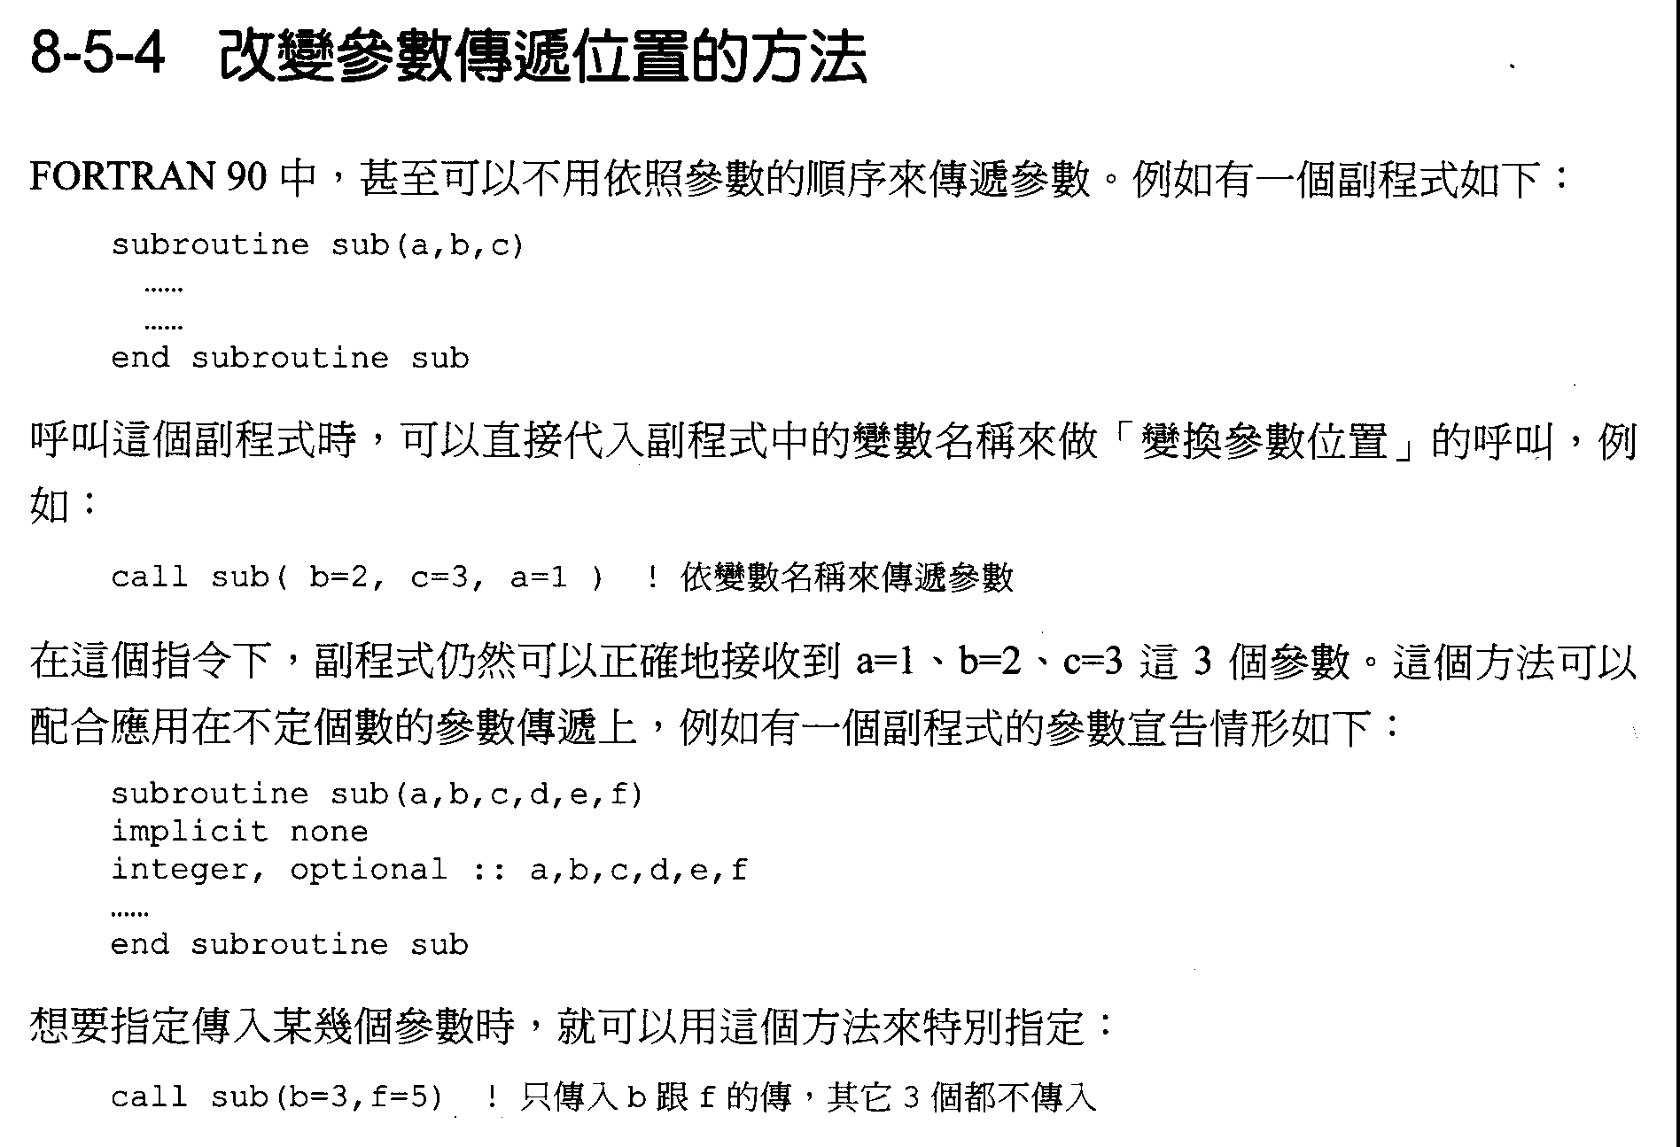
In FORTRAN 90, the order of arguments is not necessary to be fixed when sending them.
For example:
When calling the subroutine, variables can be used to send their values without following a certain order. For example:
With this line, subroutine can receive a=1, b=2, c=3 correctly. The way can be applied on the case that the number of arguments are uncertain. Take the following subroutine as an example:
If only few arguments are going to be sent, the way can used to assign them:

Slide 33
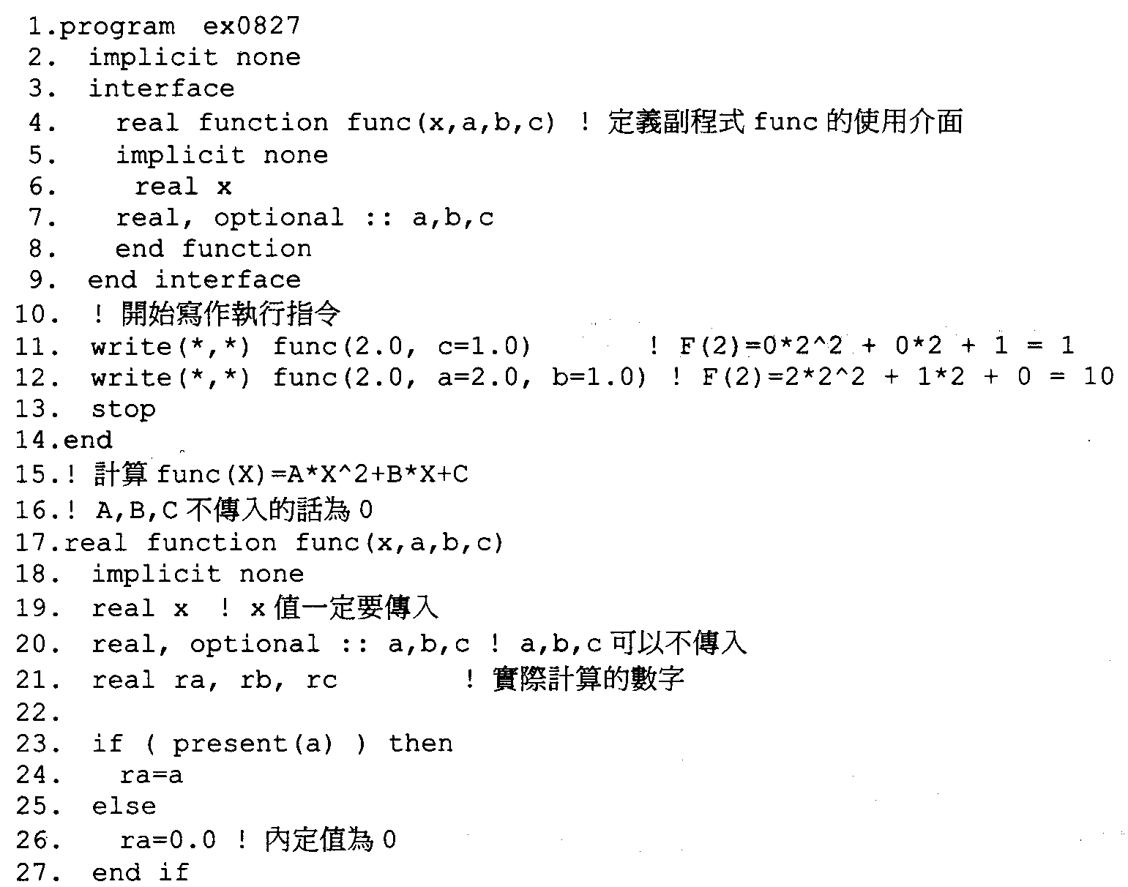

Slide 34
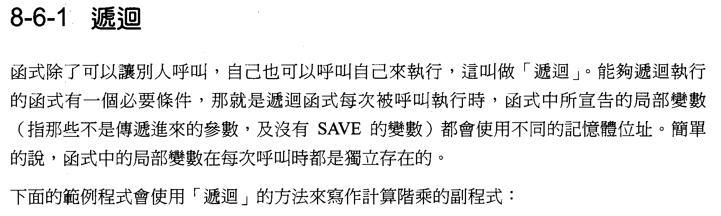
Recursive –function call by itself
Functions can not only be called by others, but also be called by itself. It’s called “recursion”. A necessary condition for a function to do recursion, that is the local variables (not received from outside or with no SAVE) declared in the function will use different memory address. Briefly speaking, all local variables in a function with each different calling are independent.
The following example is using “recursion” to calculate factorial:

Slide 35
Recursive –function call by itself

Slide 36
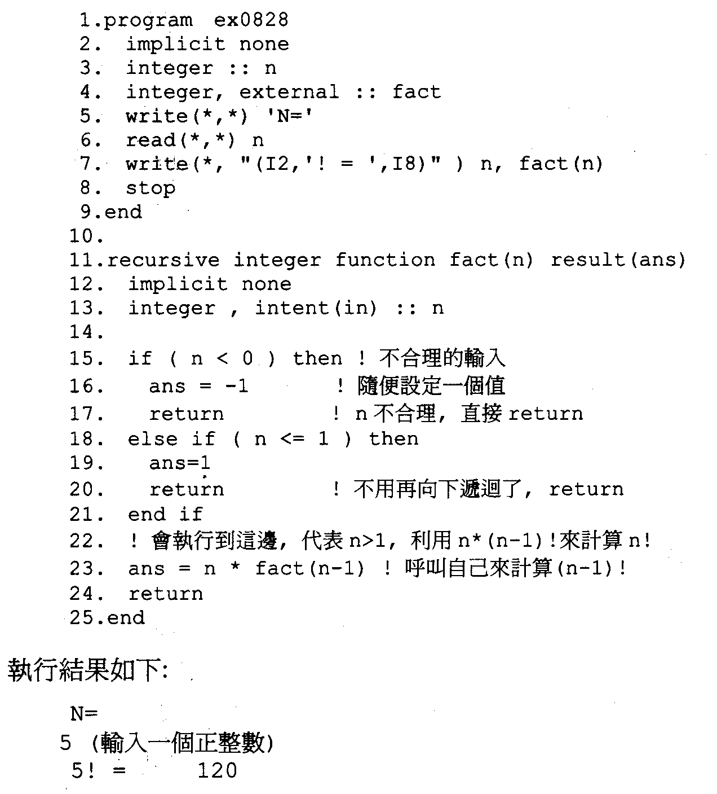

Slide 37
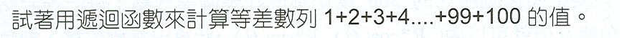
練習 Exercise
Using recursive function to count the sum from 1 to 100

Slide 38
Home work 6-I
請將1999.lis檔案中台灣島內的地震挑出！
Please plot on-land earthquake distribution data read from 1999.lis file.
Taiwan coastal lines file (Taiwan.txt)
Using SUBROUTINE
locpt (x0, y0, x, y, n, l, m)

Slide 39
SUBROUTINE locpt (x0, y0, x, y, n, l, m)
!-----------------------------------------------------------------------
! GIVEN A POLYGONAL LINE CONNECTING THE VERTICES (X(I),Y(I)) (I = 1,...,N)
! TAKEN IN THIS ORDER. IT IS ASSUMED THAT THE POLYGONAL PATH IS A LOOP,
! WHERE (X(N),Y(N)) = (X(1),Y(1)) OR THERE IS AN ARC FROM (X(N),Y(N)) TO
! (X(1),Y(1)). N.B. The polygon may cross itself any number of times.
! (X0,Y0) IS AN ARBITRARY POINT AND L AND M ARE VARIABLES.
! On output, L AND M ARE ASSIGNED THE FOLLOWING VALUES ...
! L = -1 IF (X0,Y0) IS OUTSIDE THE POLYGONAL PATH
! L = 0 IF (X0,Y0) LIES ON THE POLYGONAL PATH
! L = 1 IF (X0,Y0) IS INSIDE THE POLYGONAL PATH
! M = 0 IF (X0,Y0) IS ON OR OUTSIDE THE PATH. IF (X0,Y0) IS INSIDE THE
! PATH THEN M IS THE WINDING NUMBER OF THE PATH AROUND THE POINT (X0,Y0).
! Fortran 66 version by A.H. Morris
! Converted to ELF90 compatibility by Alan Miller, 15 February 1997

Slide 40
IMPLICIT NONE
INTEGER, INTENT(IN) :: n
REAL, INTENT(IN) :: x0, y0, x(n), y(n)
INTEGER, INTENT(OUT) :: l, m
! Local variables
INTEGER :: i, n0
REAL :: angle, eps, pi, pi2, sum, theta, theta1, thetai, tol, u, v
! ****** EPS IS A MACHINE DEPENDENT CONSTANT. EPS IS THE
! SMALLEST NUMBER SUCH THAT 1.0 + EPS > 1.0
eps = EPSILON(1.0)

Slide 41
Homework 6-2
請由21032239.p01的地震檔案中讀入，震央距離當X，P波走時當Y。去Fit Y=aX+b 的直線，求a, b, fitting SDV.
使用主軸法
subroutine xyfit(x,y,ndata,cept,slop,rms,r_cor,sdv)
real*4 x(ndata),y(ndata)

Slide 42
Homework 6-2
Please read epicentral distance as X and P wave arrive time as Y from the file 21032239.p01 to Fit Y=aX+b, please determines a, b as well as fitting standard deviation considering errors from X and Y.
subroutine xyfit(x,y,ndata,cept,slop,rms,r_cor,sdv)
real*4 x(ndata),y(ndata)

Slide 43
Homework 6-3
By using Least-square method to write a location program. Input N stations (xi,yi,zi) and distance (Di) to target point. And calculating the X,Y,Z of target point. Just like GPS location!

Slide 44
C Set observation station position : X, Y, Z
C Sat. Position, Distance : Xi, Yi, Zi, Di
C Eq:
C (Xi-X)**2 + (Yi-Y)**2 + (Zi-Z)**2 = Di**2 ...............(1)
C Set X=X0+DX, Y=Y0+DY, Z=Z0+DZ ...............(2)
C (2)-->(1) and neglect high order terms, We can get next eq.
C
C (X0-Xi)*DX + (Y0-Yi)*DY + (Z0-Zi)*DZ
C = 0.5 * (Di*Di - (Xi-X0)**2 - (Yi-Y0)**2 - (Zi-Z0)**2) .......... (3)
C D = G * M ...............(4)
C Least-square method
C T -1 T
C M = [G G ] G D ...............(5)
C Find DX, DY, DZ
C Do iteration DX->0, DY->0, DZ->0. Now can find X, Y, Z

Slide 45
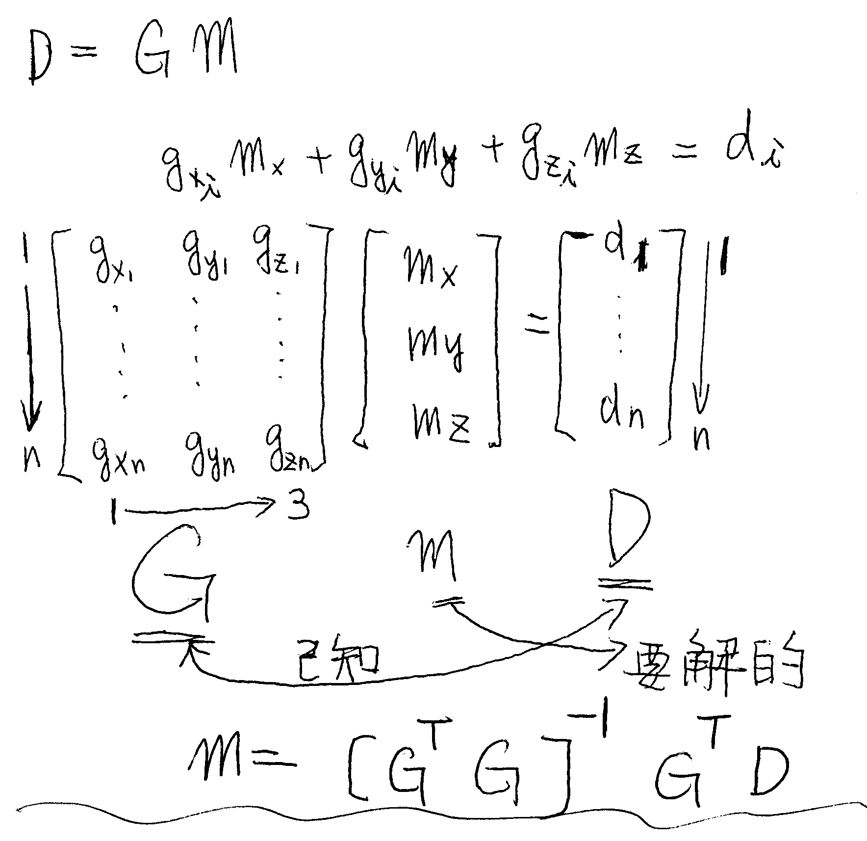

Slide 46
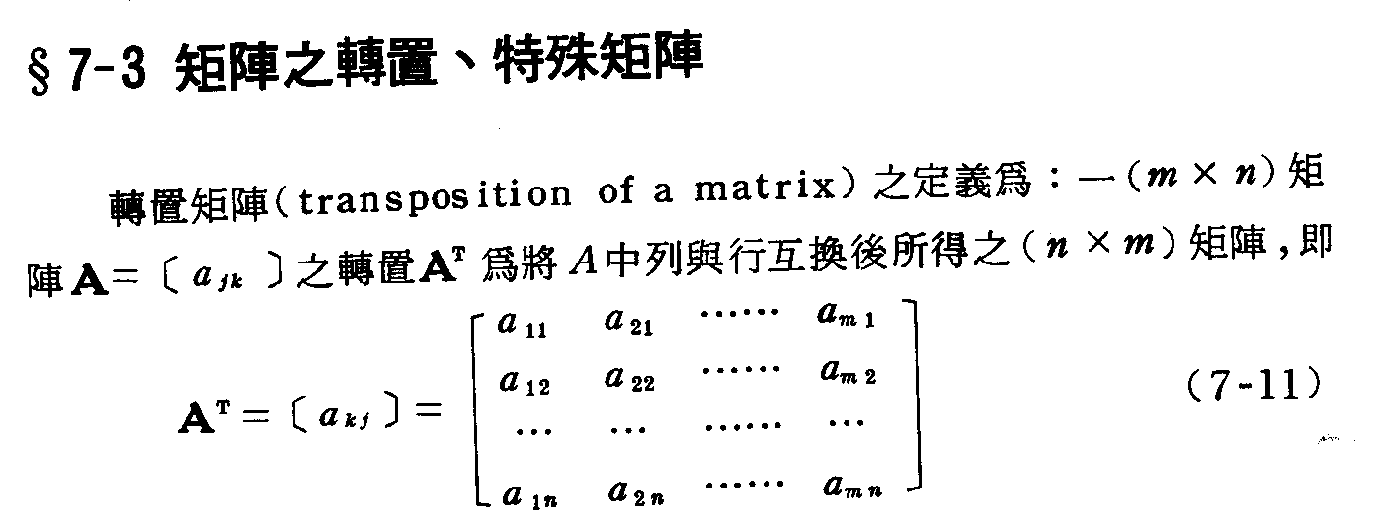

Slide 47
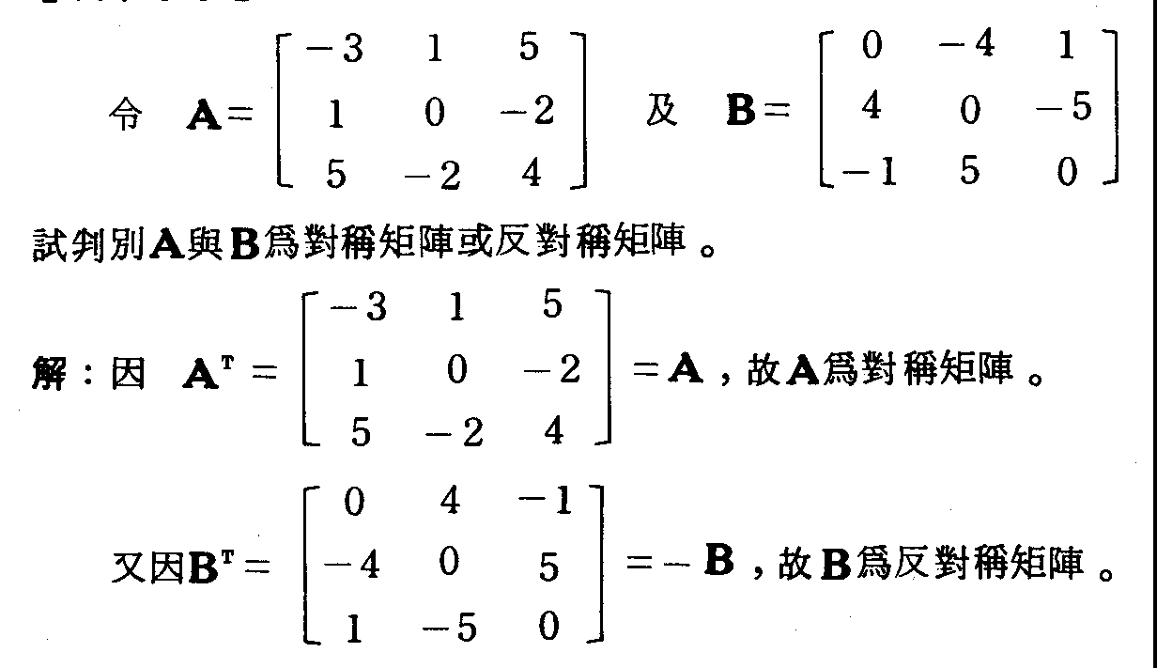

Slide 48
Matrix Transpose
Intrinsic Function Transposes the columns and rows of a matrix (two-dimensional array).
Syntax
result = TRANSPOSE (matrix)
matrix (Input) Any type. Must be a two-dimensional array. Matrix whose elements are to be transposed.
Return Value
Same type and kind as matrix with the columns and rows transposed. If matrix has shape (k,n), the result has shape (n,k).

Slide 49
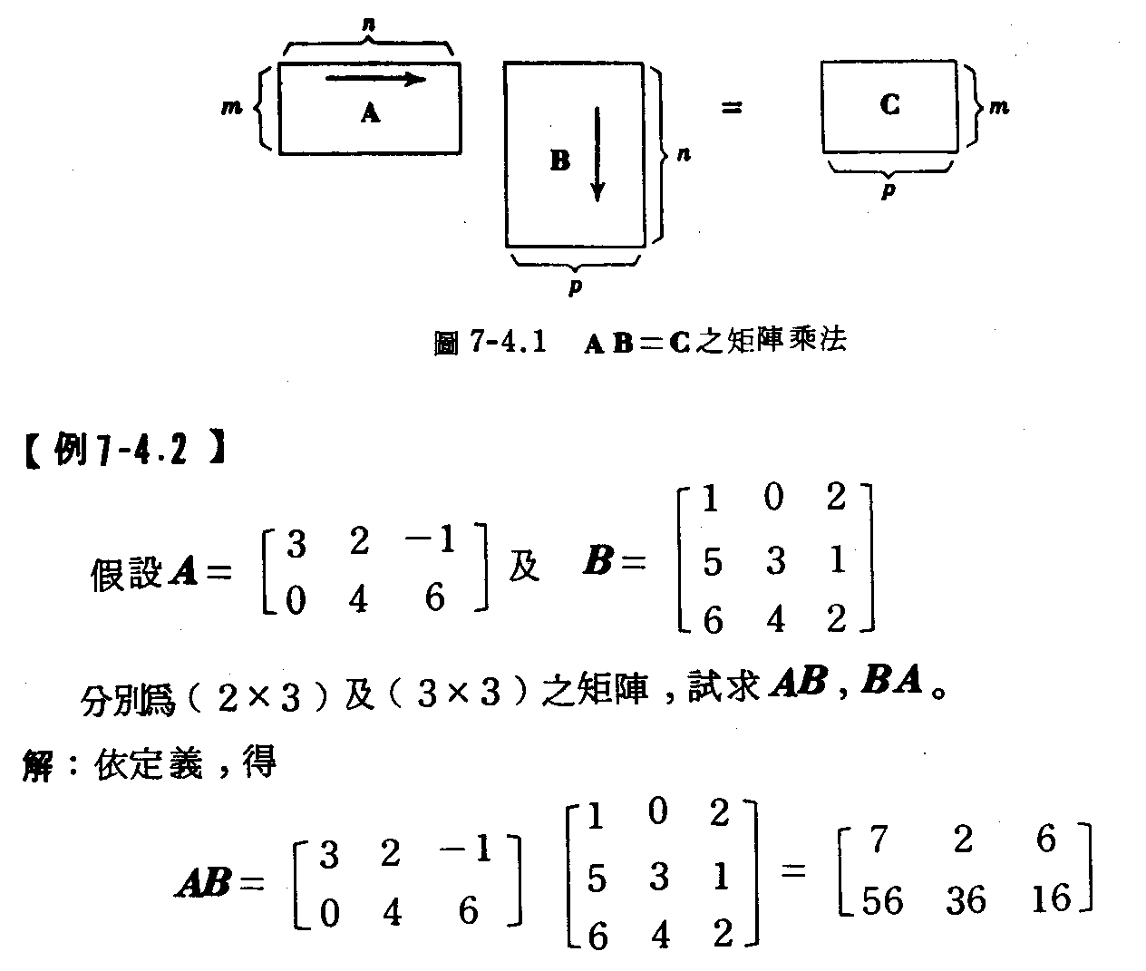

Slide 50
Matrix Multiplication
Purpose
Intrinsic Function Performs matrix multiplication on integer, real, complex, or logical matrices.
Syntax
result = MATMUL (matrix_a, matrix_b)

Slide 51
Find matrix inverse from numerical recipes
subroutine MATRIXINV(c,n)
parameter (nb=3)
dimension c(nb,nb),indx(nb),y(nb,nb)
DO I=1,n
DO J=1,n
y(i,j)=0.
ENDDO
y(i,i)=1.
ENDDO
call LUDCMP(C,N,INDX,D)
do j=1,n
CALL LUBKSB(C,n,indx,y(1,j))
enddo
DO I=1,n
DO J=1,n
C(I,J)=y(i,j)
ENDDO
ENDDO
RETURN
END subroutine MATRIXINV

Slide 52
Input data
X,Y, Z, Distance
(1,1,0,1.42),(-1,-1,0,1.42),(1,-1,0,1.41),
(-1,1,0,1.43),(2,0,0,2.1)
Initial position (20,20,20)

